Slide 1

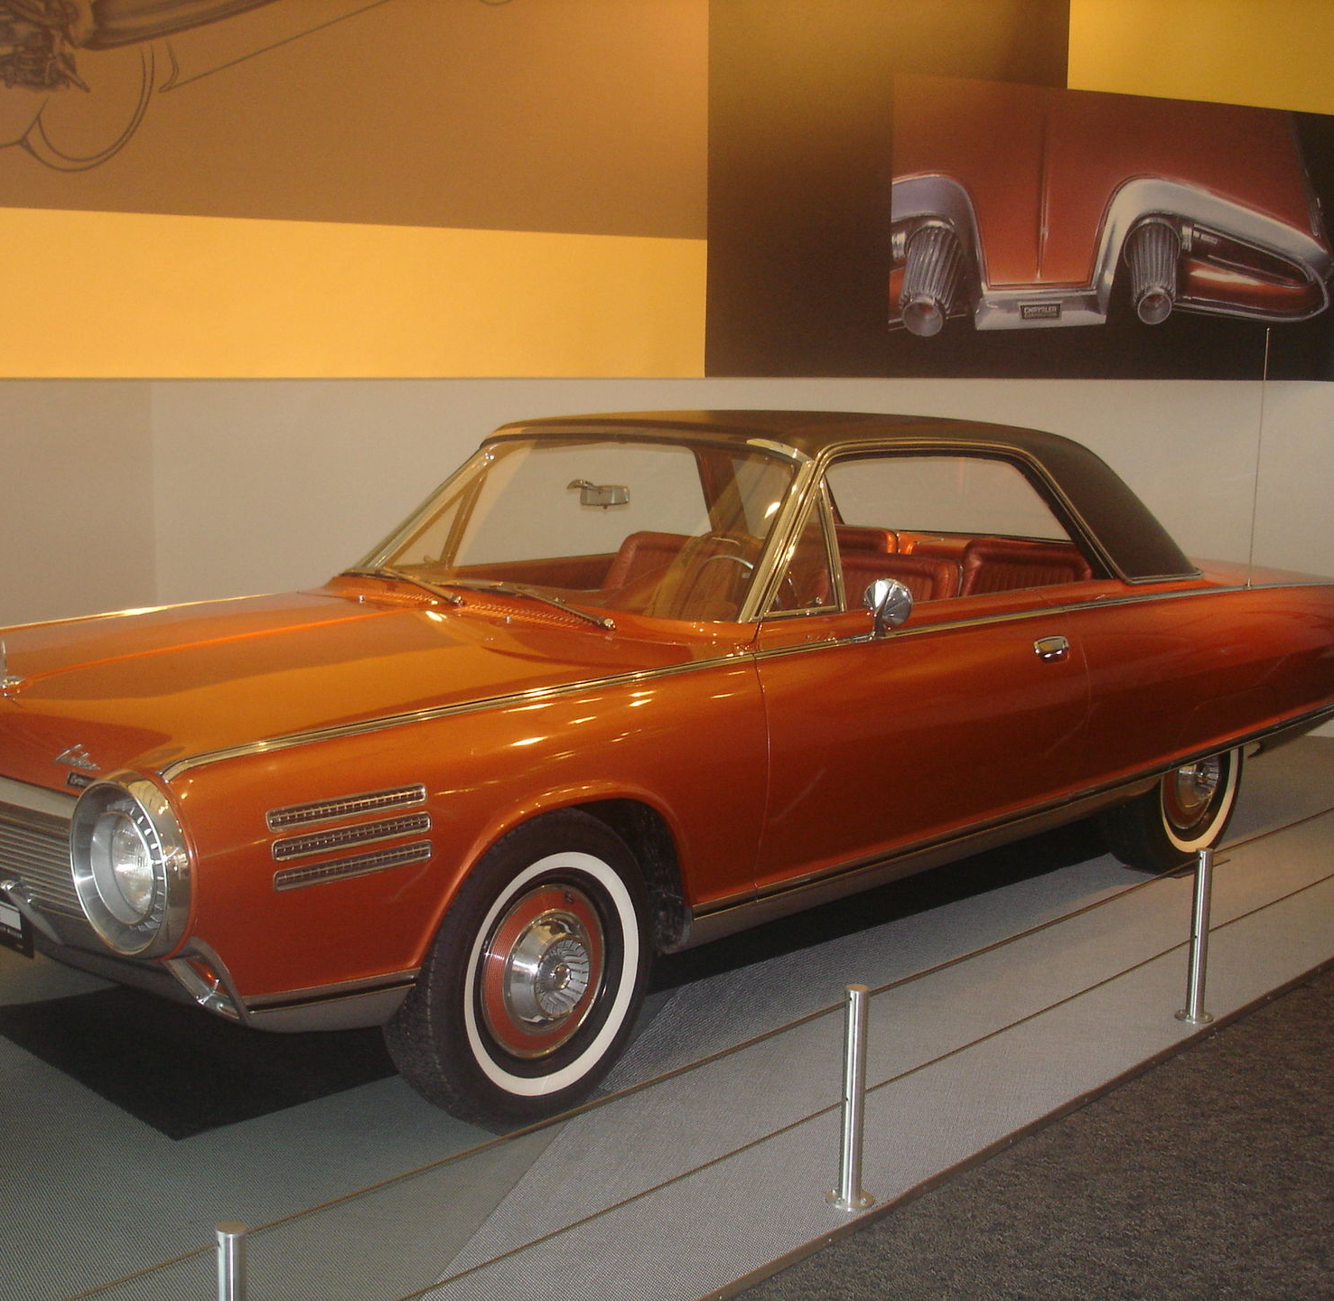
What the MPG?
This Photo by Unknown Author is licensed under CC BY-SA

Slide 2
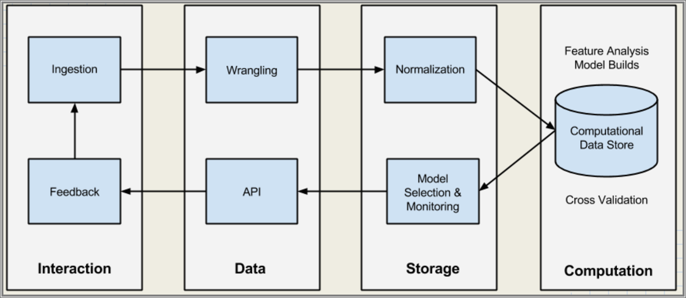
Problem: Contract Delivery Business
Owner of a private delivery business and I need to determine what car has the most efficient Miles per Gallon (MPG) for my drivers?

Slide 3

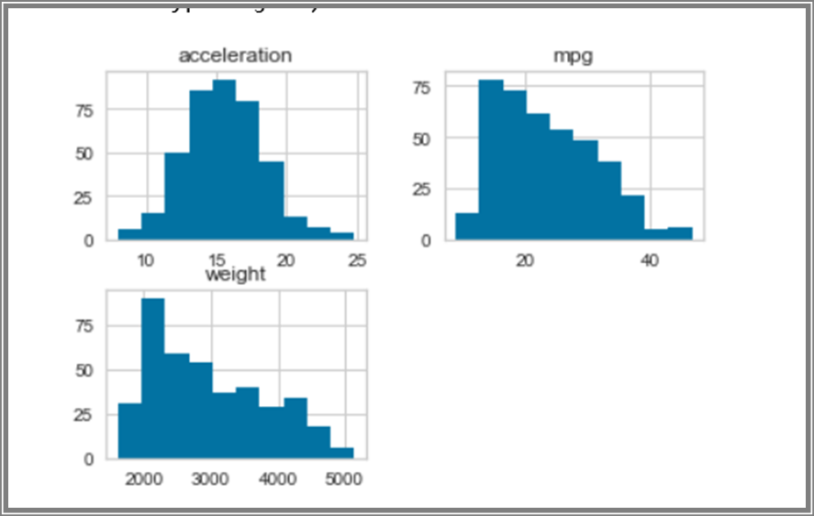
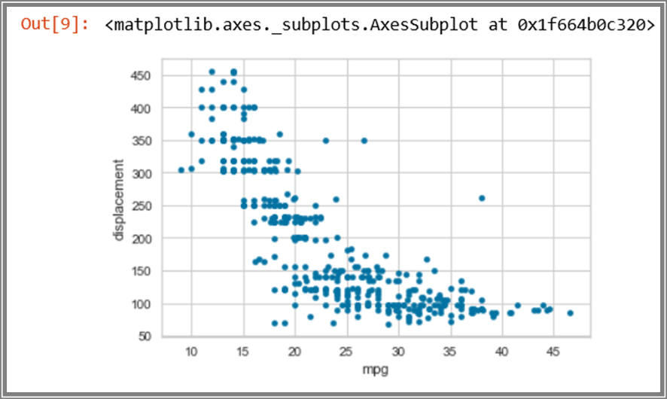
Exploratory Data Analysis

Slide 4
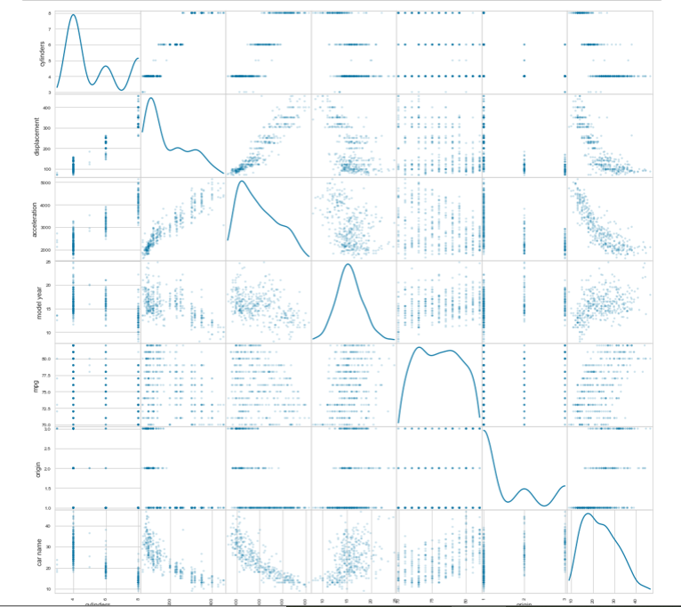
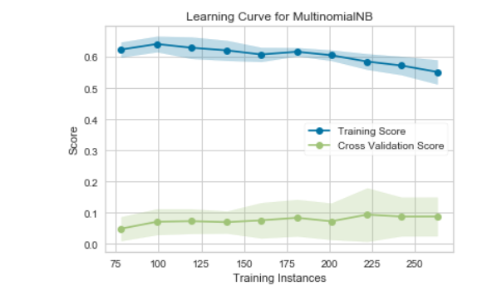

Slide 5
What does this mean?

Slide 6

Conclusion
The model does not support, what car should be used for my Contract delivery business.
More data, time, and analysis is needed to create a more efficient and accurate model.
This Photo by Unknown Author is licensed under CC BY

